Slide 1
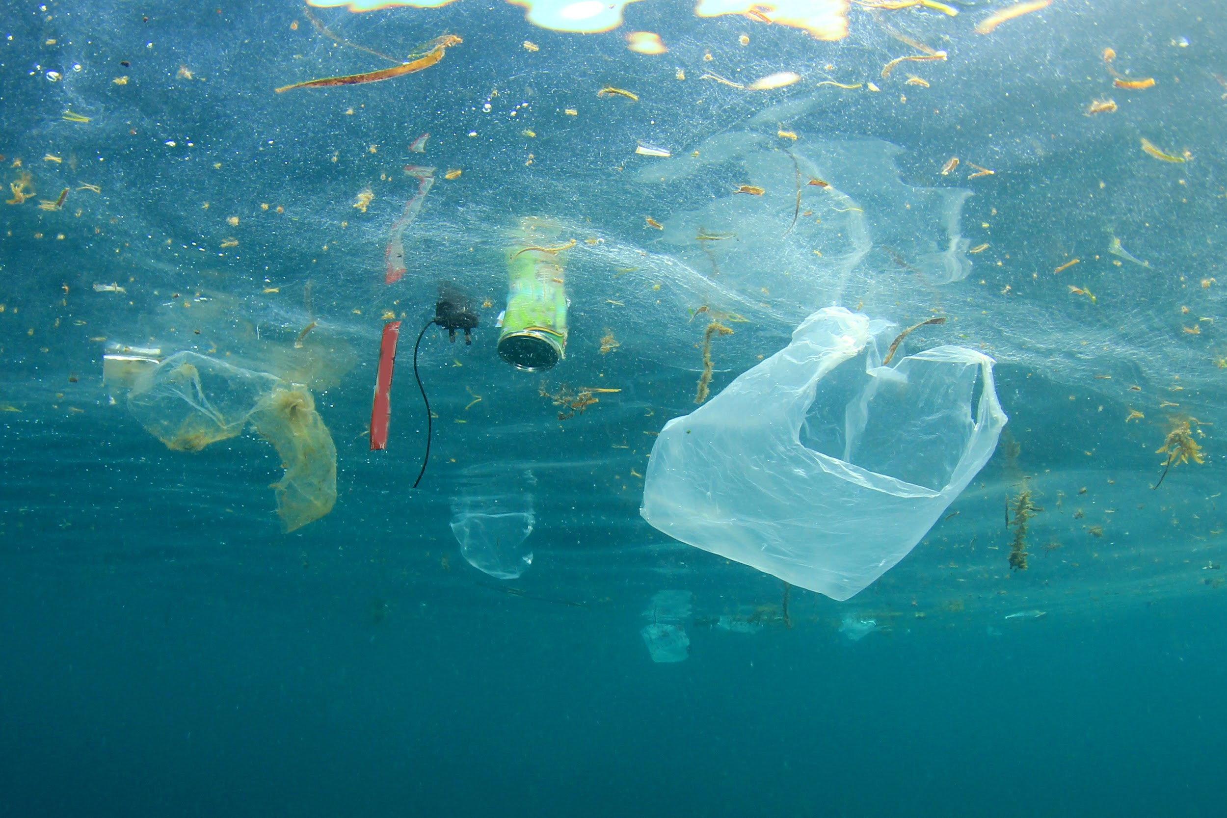
Rubber Duck Solutions
Jonathan Vargas & Carter Brezinski
Scrum #2
Notes:
J: Hello everyone We are team Rubber Duck Solutions I’m Jonathan and my partner is carter brezinski

Slide 2
Table of contents
Reintroduction
Project Update
Project Issues
Project Changes
Plans for the next coming weeks
Reflections
Notes:
J: today we will talk about our scrum 2 activities and any interesting tidbits we found

Slide 3
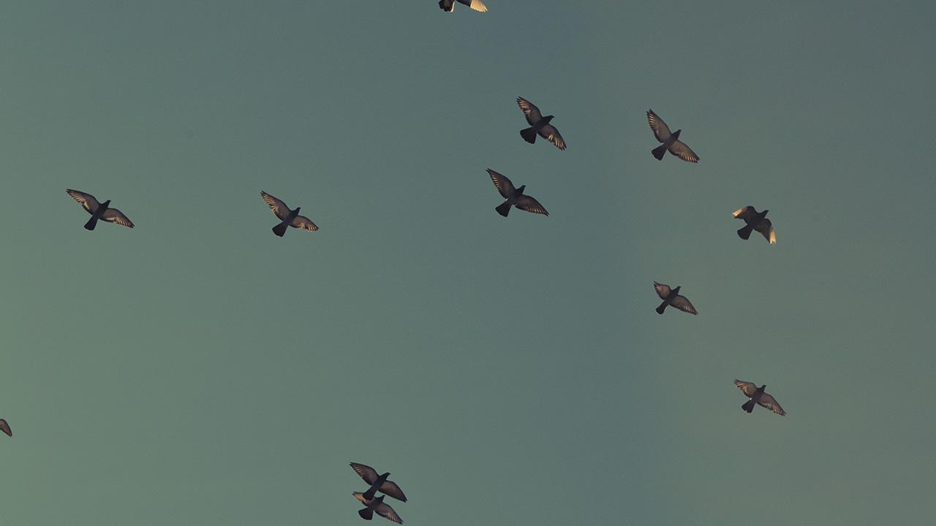
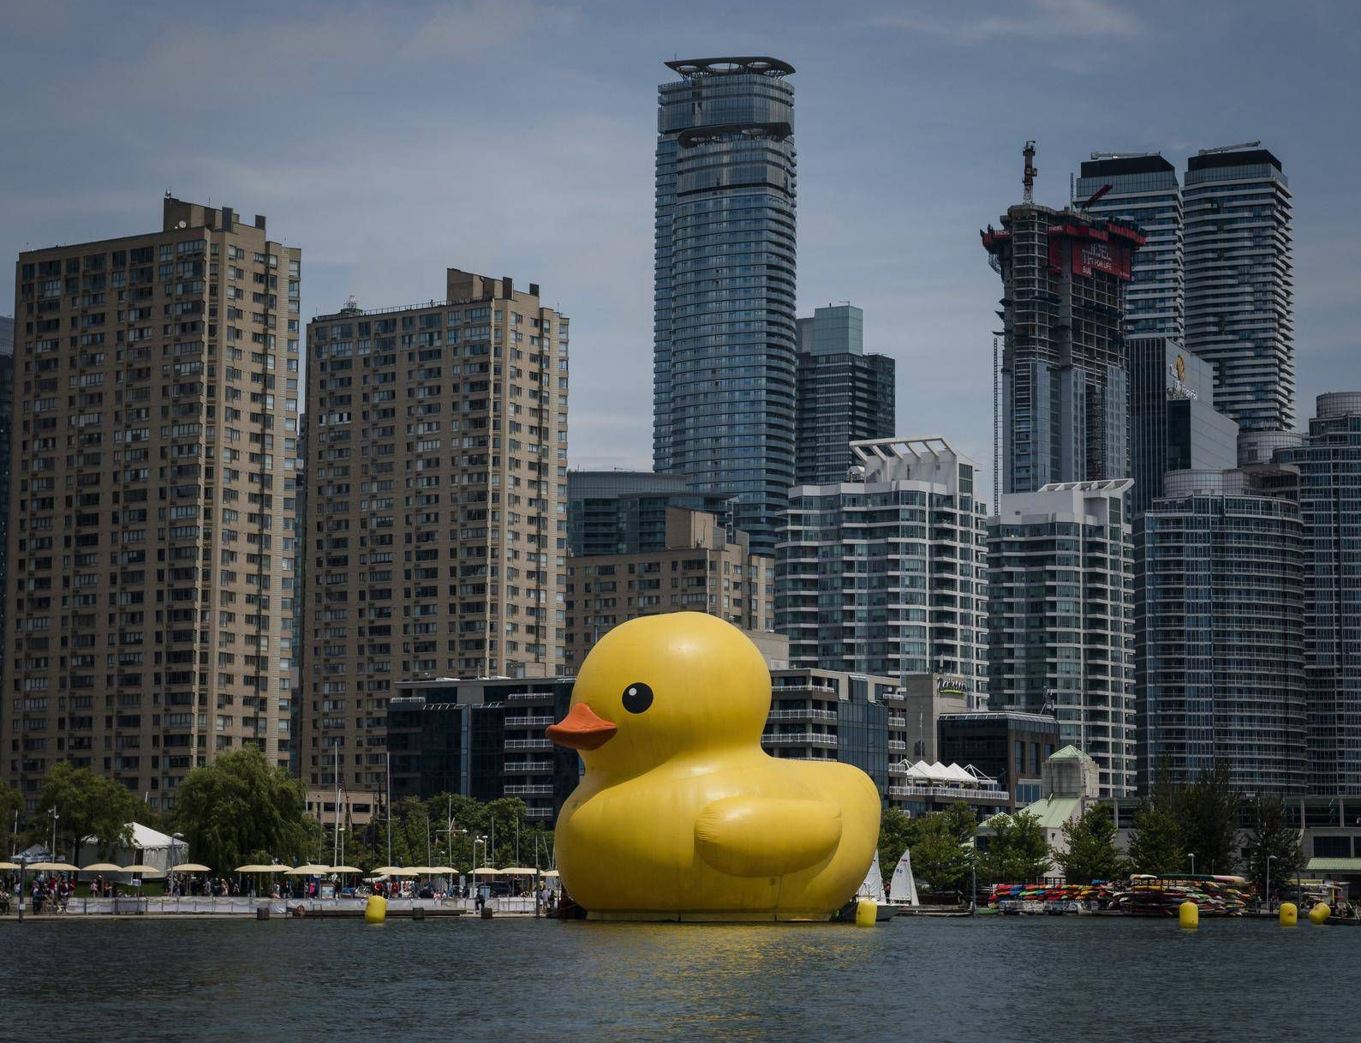
What are we doing?
Notes:
J:
To reintroduce what we’re doing our project is called FLOAT
FINDING LITTERED OBJECTS AUTOMATED TECHNOLOGY.
Its an image recognition system that is used to detect any litter
floating within the water

Slide 4
Project Update So Far
Notes:
https://github.com/Rubber-Duck-Solutions/F.L.O.A.T.

Slide 5
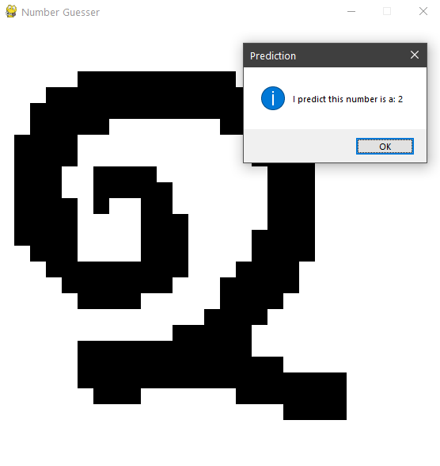
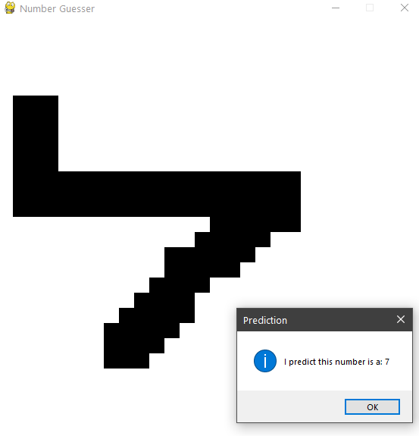
Experimentation: Testing with Google Colab
Notes:
C: During the week I spent the time to import over a previous AI project of mine to google colab and test its efficiency compared to running individually on my system. This was a project that would typically take me about 10-15 minutes to generate. With Google Colab training took less than 3 minutes, and back to back generation was almost instant after the fact. I can genuinely say that the results were night and day.
40s

Slide 6
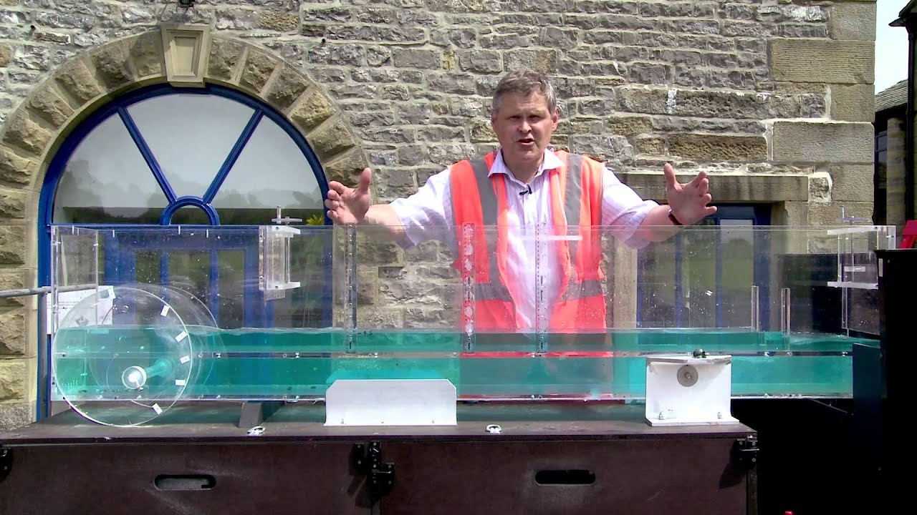
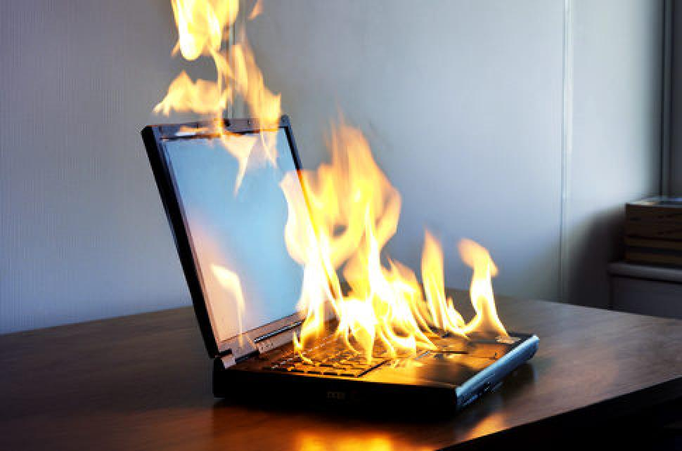
Project Issues
Training - potentially
Will we have a consistent place to test our project?
Future potential issues: the hardware the software will have to run off of. Ie: laptop? phones?
Notes:
C:All of these can be easily resolved, but these are worries or issues that we are going through right now.

Slide 7
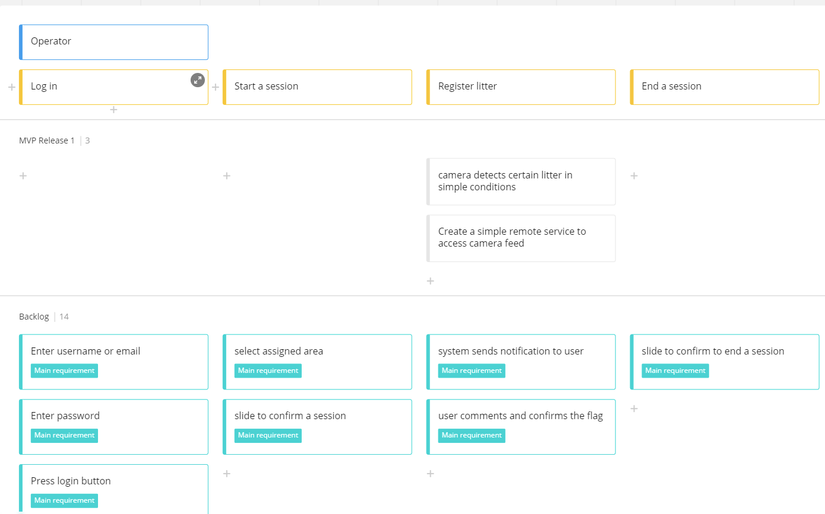
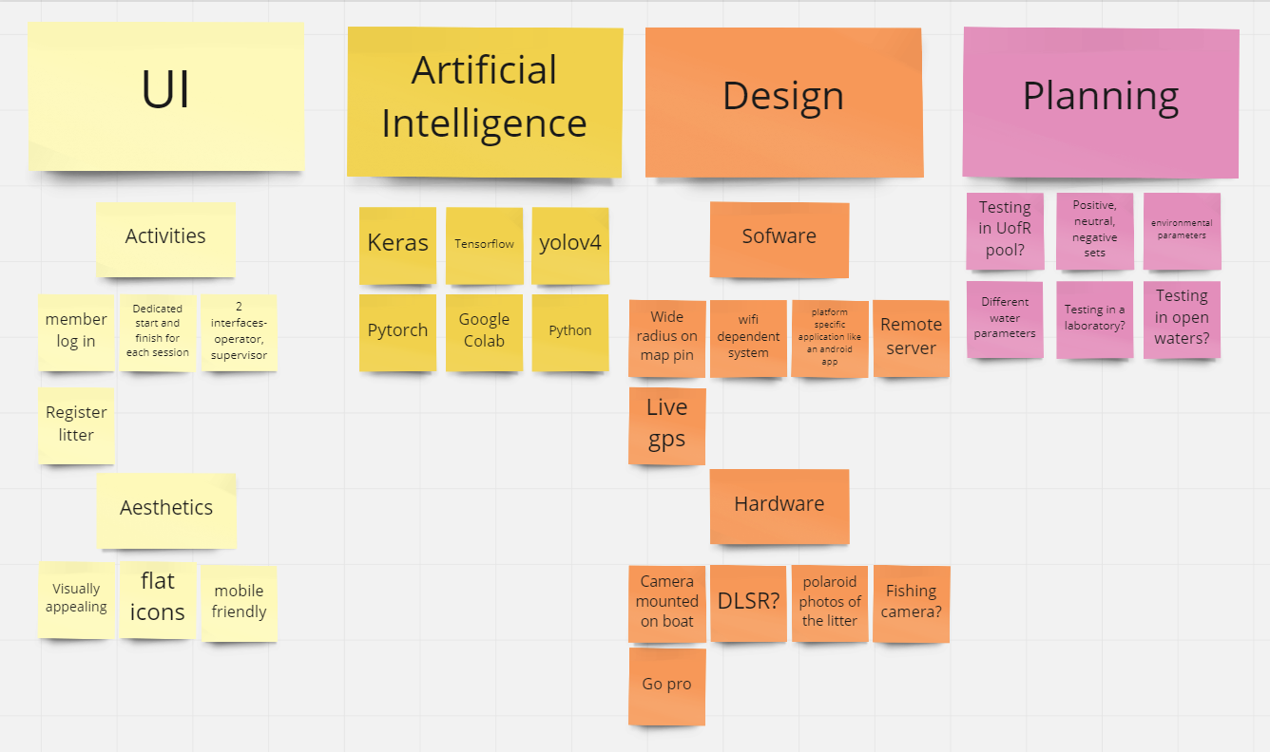
Documentation
Notes:
https://github.com/Rubber-Duck-Solutions/F.L.O.A.T.
As for documentation we refined our ideas with our affinity map diagram and basic user story maps. These have helped us with creating a more detailed view on our project and future scrum activities. We look to further develop our user story map as we progress through the planning/design phase.

Slide 8

Status of The Project:
Green
Notes:
C: To give a brief overview of how we’re feeling in regards to the status of the project, we’re feeling good based on the amount of quality information we’ve found so far. We found a viable dataset, which was one of our big hurdles.
J: We have accomplished all of the goals we have set for each other minus the lo-fi prototypes as we feel we are not ready to create yet with the state of the project (which in my opinion is totally fine that we haven’t decided on that yet)

Slide 9
What is next?
Notes:
J:
We are aiming to schedule a meeting with one of our contacts at the UofR to see if their hydraulic flume would be viable for our testing
Additionally, we are working to create our initial professional documentation and abstracts, specifically those for another contact that we have with the government of Saskatchewan.
Dimensions are about 10m long, 0.6m wide, and the water runs up to about 0.2
C:
For myself I am going to begin the very initial stages of R&D on google colab for our project. That will involve research regarding a live video feed, as we stated that was something we’d hope to begin figuring out for our MVP 1.

Slide 10
Team Reflection
Notes:
C:
Overall do we feel on track after our second week?
There are a few portions in regards to documentation that we need to get refined and worked out to feel fully on track.
We’ve gotten in contact with 2 very beneficial contacts, they will be able to assist us with resources, testing facilities, and consulting should we require it in the future.
Experimentation went really well so far with google colab

Slide 11
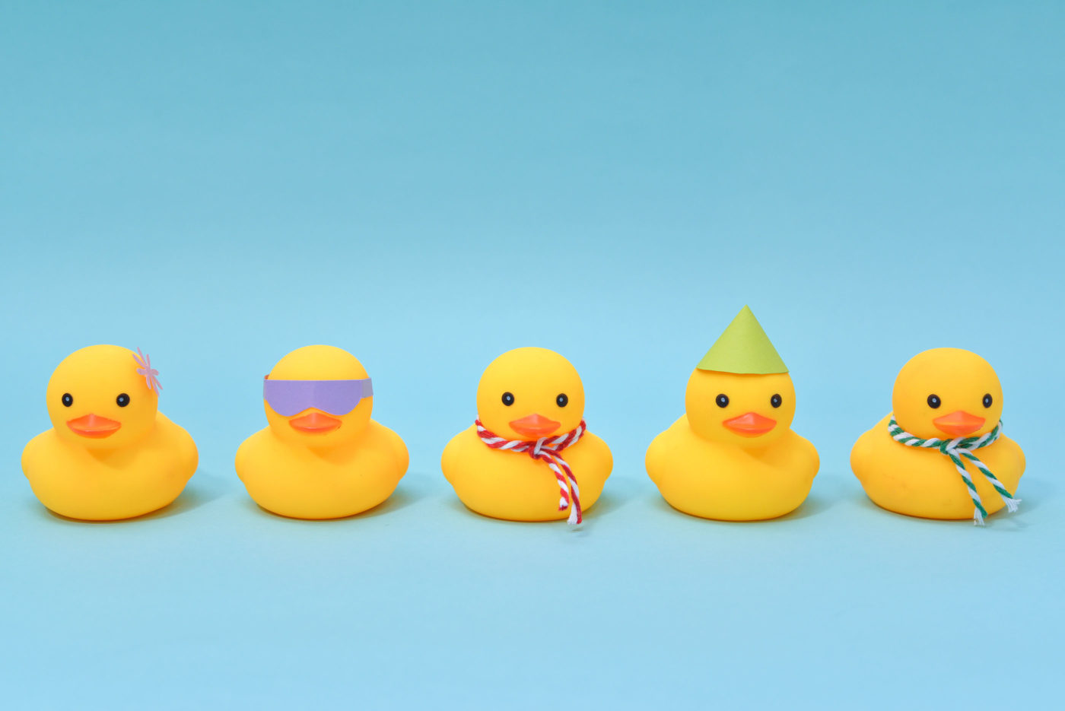
Thank you for listening

Slide 12

After mentor meeting takeaways
Neutral Set, Positive Set, Negative Set
Will our dataset be enough?
Notes:
Last week we had our second meeting with our mentor Dr. Christine Chan, and here were a few takeaways that we took from our meeting with her.
We will need to decide on what will end up being our positive, neutral, and negative data set. For this we will need to be able to distinguish fish from rocks & algae, and from garbage.
And will our dataset be enough?

